Slide 1
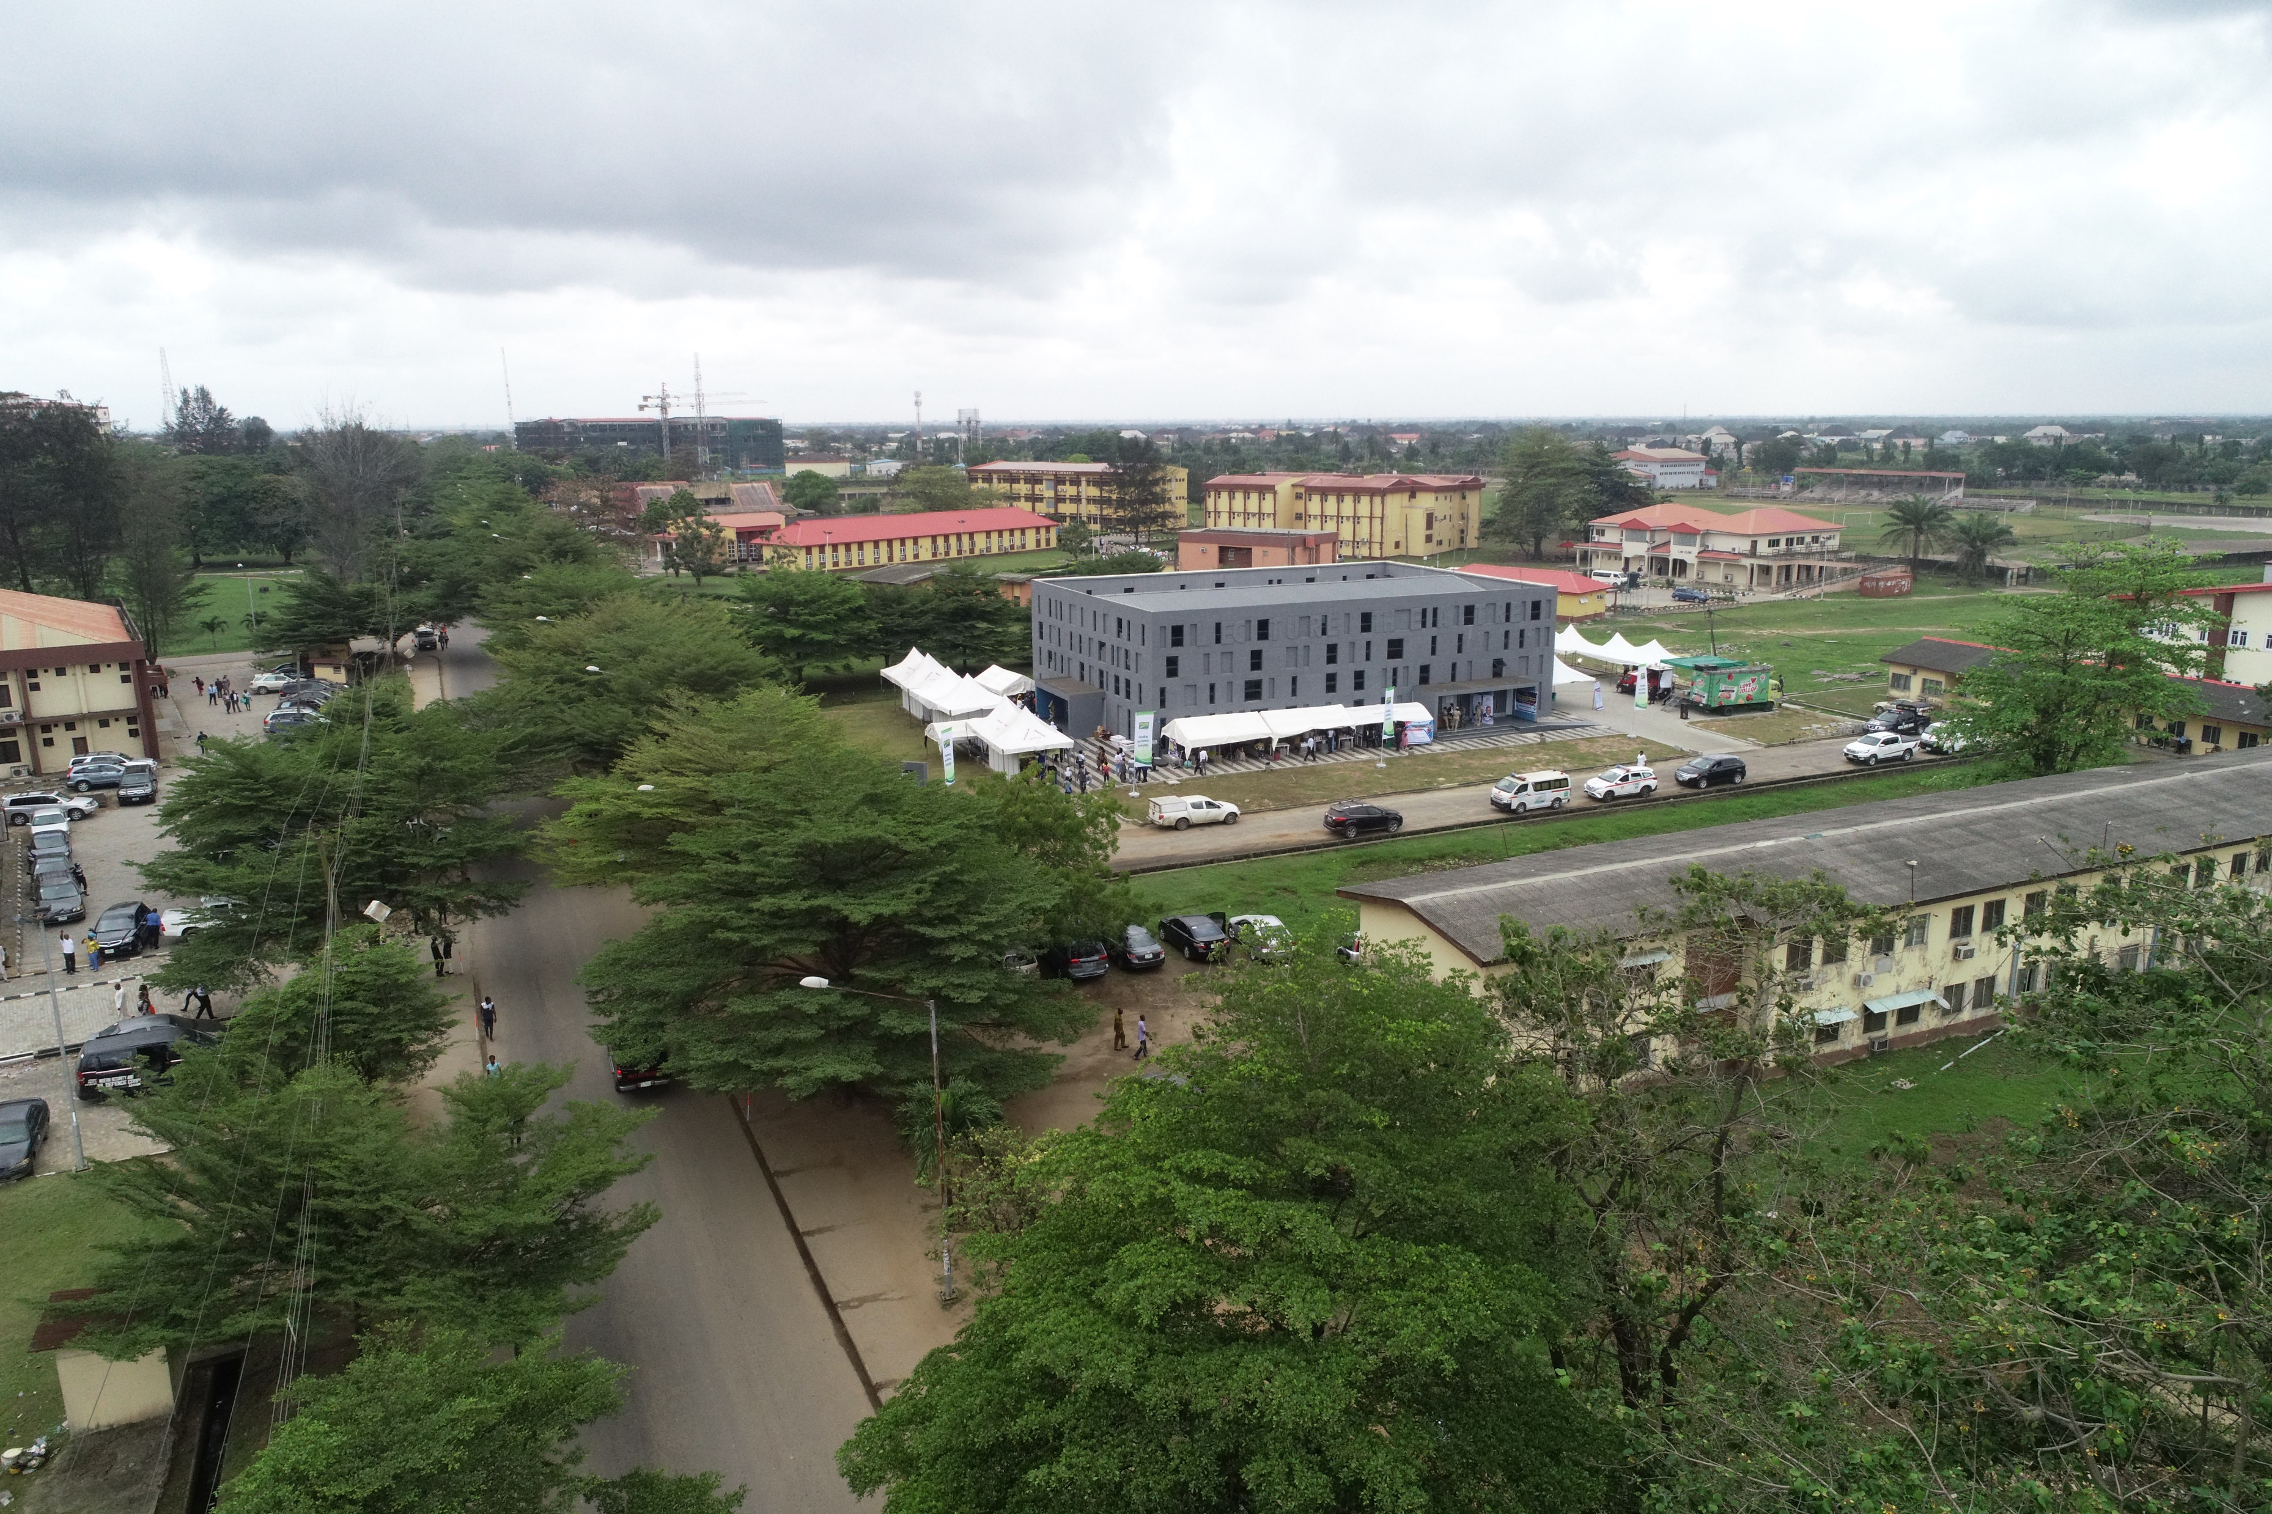
LAGOS STATE
LASU COVID-19
Public Lecture Series
UNIVERSITY

Slide 2
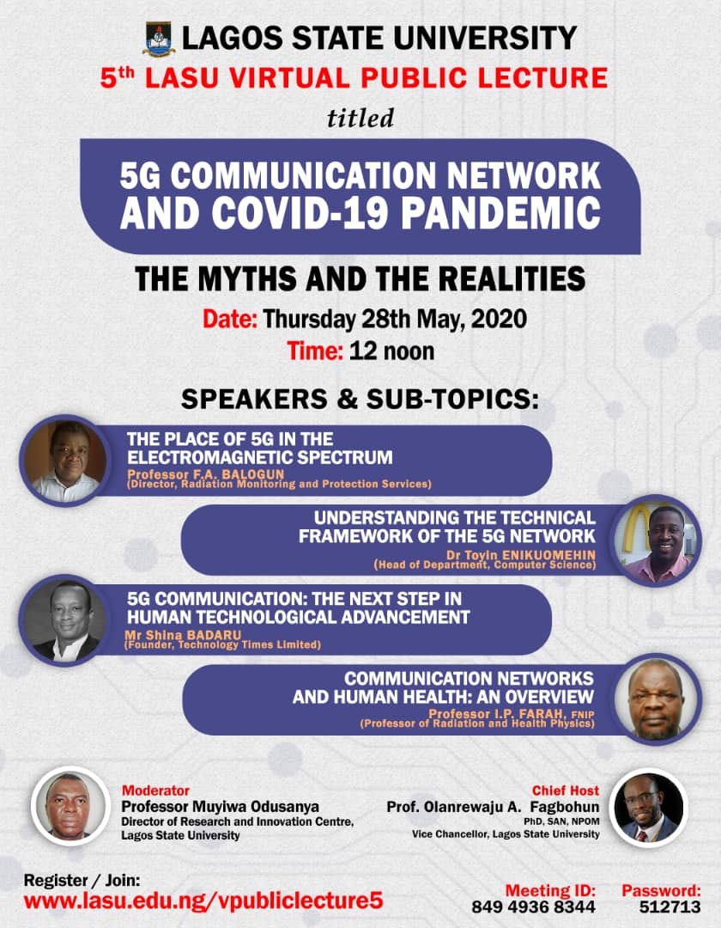
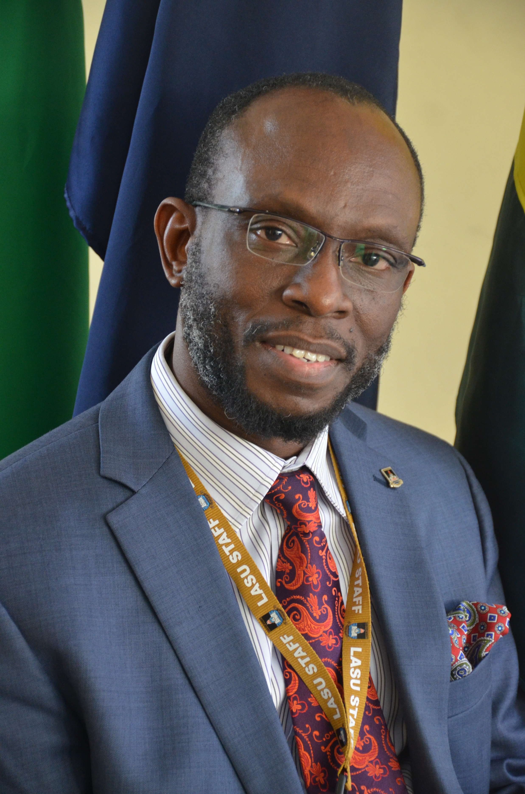
Chairman Professor Olanrewaju A. FAGBOHUN PhD, SAN National Productivity Merit Award Winner, 2019
Vice Chancellor Lagos State University

Slide 3
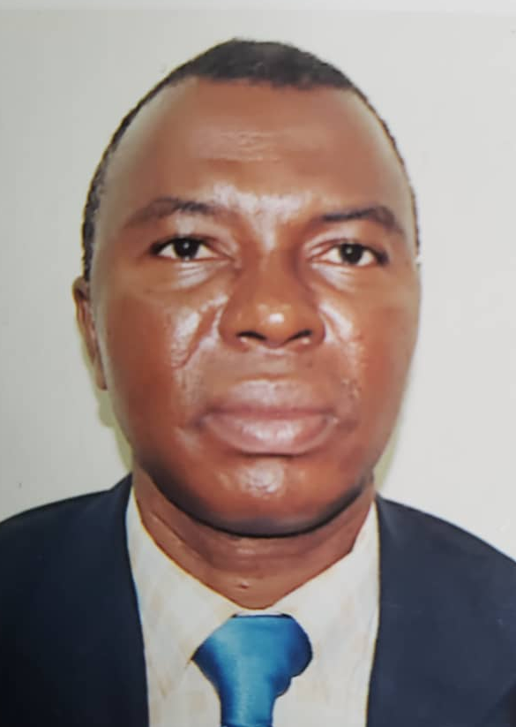
Moderator
Professor Olumuyiwa Odusanya
Director, Research & Innovation
Lagos State University
Image Source: https://www.ecowas.int/

Slide 4
5G Technology our focus: any harm, any benefit, any role in COVID-19
Notes:
5G Technology our focus: any harm, any benefit, any role in COVID-19

Slide 5
5G. Introduction
A completely new paradigm to the communications world with the potential to rapidly transform not only the mobile and smartphone industries,
This fast revolution in mobile computing changes our work pattern, interactions and learning.
However, there is an increasing level of apprehension and uncertainty in relations to the 5G network which is daily sending anxiety in different parts of the world, with numerous conspiracy theories around the globe.

Slide 6
Objectives of Lecture
Intends to identify 5G as the next logical step in the development of GSM technology
To bridge knowledge-gap of the misconceptions and truth regarding the network framework of fifth-generation technology in the aetiology of COVID-19 pandemic

Slide 7
SPEAKERS AND TOPICS

Slide 8
The place of 5G in the electromagnetic spectrum by Prof. Balogun F.A. Director, Radiation Monitoring and Protection Services.
Professor Balogun became a Professor of Physics in 2002.
He was the pioneer Director/CEO of the National Institute of Radiation Protection and Research, University of Ibadan between 2005 to 2012.
He has served on several Expert Missions.
He is currently on Sabbatical at the Lagos State University Radiation Monitoring and Protection Services.

Slide 9
Understanding the Technical Framework of the 5G Network by Dr Toyin Enikuomehin. Head of Department, Computer Science.
DR. Toyin Enikuomehin is an experienced network deployment professional whose research interest span over a number of areas, including natural language processing, information retrieval, Networking, Internet of everyThing (IoT) and recently computer vision.
He is a member of many reputable organizations and Chairs the Africa cohort of the IR subgroup of the British Computer Society.
Enikuomehin has been involved in several deployment of internet infrastructure within and outside the University,

Slide 10
5G Communication: The next step in human technological advancement by Mr Shina Badaru. Founder, Technology Times Limited.
Mr Shina Badaru is the Founder, Technology Times Media Limited, a media, events and business services organisation focused on showcasing Nigeria’s growing contributions to the information and communication technology (ICT) industry.
He is a Member of the Board of Trustees (BoT) of the Nigeria Internet Registration Association (NiRA) was the President of the Joint Action Committee on IT Awareness and Development, (JACITAD), the umbrella body of ICT Journalism in Nigeria;
Mr Badaru is a renowned public speaker on media, information technology and new media technology themes across Africa and beyond.
He has earned many awards and recognitions, including the first Nigerian recipient of the SAP African Technology Reporting Award in 2001 and First Prize Winner of UN African Media Awards on Local ICT Content.

Slide 11
Communication Networks and Human Health: An Overview by Prof. Farai I.P. Professor of Radiation and Health Physics.
Professor Idowu P. Farai is a Professor of Radiation and Health Physics.
He has published over sixty articles in reputable local and international journals in his area of research.
He is a Fellow of the Nigerian Institute of Physics (FNIP) and a member of a number of professional associations.
He is an external examiner at both undergraduate and postgraduate levels to many universities in Nigeria, South Africa and Ghana.
He is a consultant to the Federal Government of Nigeria on Radiation Protection and Nuclear Safety and also to many users of ionizing and non-ionizing radiation in Nigeria.

Slide 12
Ground Rules
Audience microphones will be put on mute
Charts to be used to ask questions and sent to moderator
Each speaker will have 10 minutes
Questions will be answered at the end of all the presentations
Have a stimulating and interesting partcipation

